Slide 1
Image Correctness for a Product on the Marketplace
CSE7101- Capstone Project
Review-4
Batch Number: CIT_51
Roll Number | Student Name
20221CIT0003 | Vikas Yadav
20221CIT0005 | Shaik Yasin Shahid
20221CIT0033 | Akhil Hari
Under the Supervision of,
Ms. Soumya
Assistant Professor
School of Computer Science and Engineering
Presidency University
Name of the Program: Computer Science and Engineering
Name of the HoD: Dr. Anandaraj S.P
Name of the Program Project Coordinator:
Name of the School Project Coordinators: Dr. Sampath A K , Dr. Geetha A

Slide 2
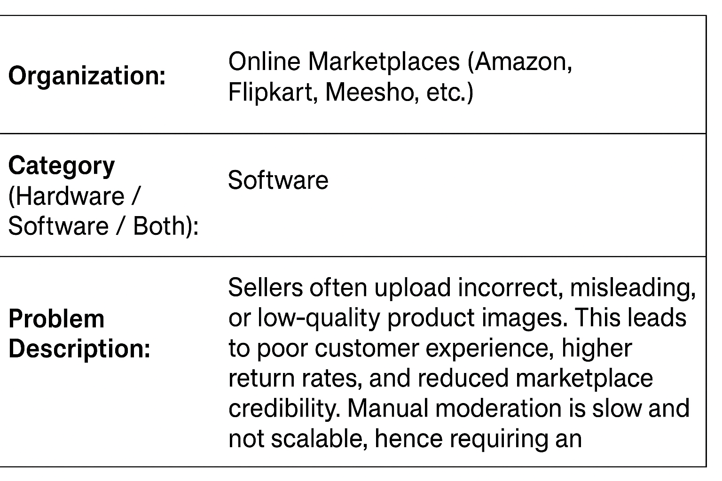
PS

Slide 3
Problem Statement
Problem Statement:
In online marketplaces like Amazon, Flipkart, or Meesho, sellers often upload product images that are incorrect, misleading, of low quality, or irrelevant. This leads to: Poor customer experience return rates, Loss of platform credibility. Manual moderation is time-consuming and not scalable. Hence, there is a need for an automated system that can verify the correctness and quality of images before they are published.

Slide 4
Objectives
Objectives:
To develop an AI-powered system that automatically verifies whether the uploaded product image is:
Relevant to the product listing
Meets marketplace quality standards
Free from policy violations (e.g., watermarks, irrelevant text, multiple objects)

Slide 5
Literature Survey
  Existing Approaches in Image Verification
  Convolutional Neural Networks (CNNs)
  Used widely for image classification tasks (e.g., plant disease detection, object recognition).
  Example: Kumar et al., IEEE Access (2021) – CNNs applied for accurate image classification.
  Object Detection (YOLO)
  Real-time object detection and bounding box generation.
  Efficient for detecting multiple objects and ensuring only one product is in focus.
  Optical Character Recognition (OCR)
  Detects embedded text or watermarks violating platform policies.
  Commonly used to extract text from images for compliance checks.
  Gaps & Motivation for Proposed Work
  Existing systems lack multimodal analysis (image + text matching).
  Most systems do not provide real-time feedback to sellers during image upload.
  Rule-based approaches alone may result in high false positives.
  Combining AI models with rules improves accuracy but needs further enhancement for marketplace use-cases.

Slide 6
Background and Related work for title Selection
Background & Related Work
Sellers often upload incorrect, low-quality, or misleading product images on marketplaces like Amazon and Flipkart, causing poor customer experience and higher return rates.
Manual image moderation is time-consuming and not scalable.
Existing solutions use CNN for image classification, YOLO for object detection, and OCR for text/watermark detection.
Rule-based validation combined with AI models improves accuracy but lacks real-time feedback and multimodal analysis.
This project proposes an automated system to ensure image relevance, quality, and compliance with marketplace standards.

Slide 7
Analysis of Problem Statement
Problem Description:
Poor Customer Experience: Buyers may be misled or get an inaccurate impression of the product.
Increased Return Rates: Misleading images can lead to customers returning products more frequently.
Loss of Platform Credibility: The trustworthiness of the marketplace diminishes when product listings are inaccurate.
Inefficient Moderation: The existing method of manual moderation to catch these issues is time-consuming and not scalable for large platforms.

Slide 8
Analysis of Problem Statement
Objectives: The specific goals of the project.
Features of the Proposed System: The planned capabilities like background validation or watermark detection.
System Architecture: The technical workflow from image upload to decision.
Tools and Technologies: The specific software, frameworks, and models to be used.
Methodology: The steps for data collection, model training, and evaluation.
Expected Outcomes: The anticipated results, such as accuracy levels and impact.
Future Enhancements: Planned improvements after the core project is complete.

Slide 9
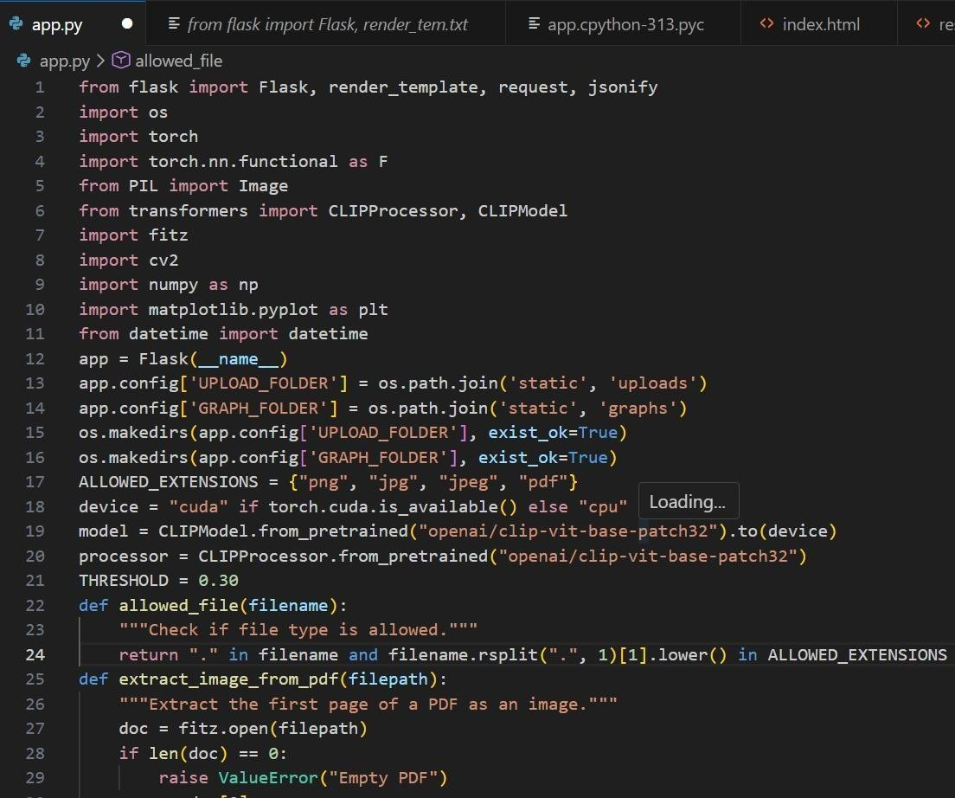
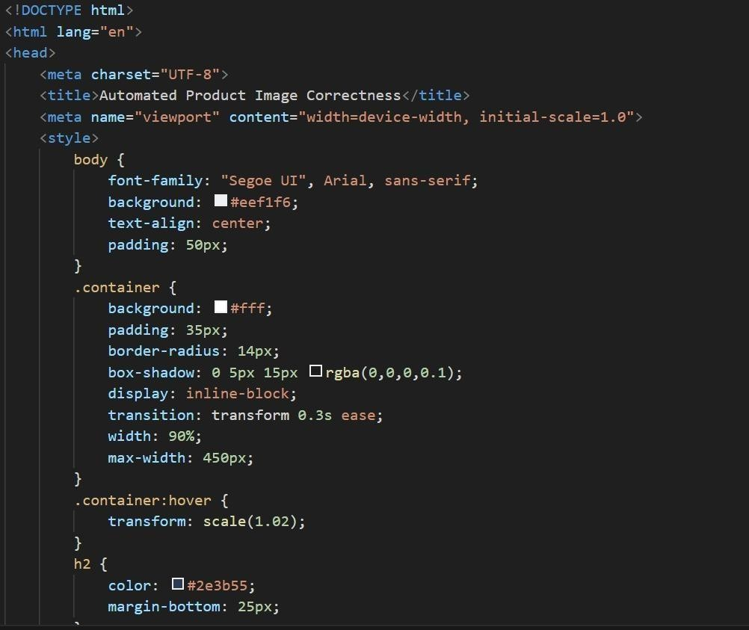
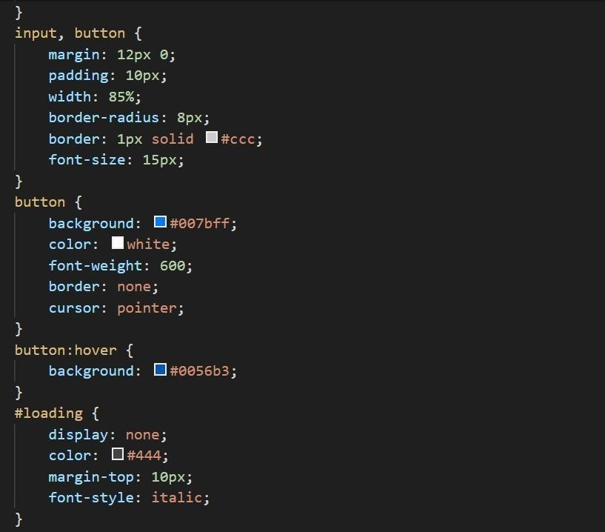
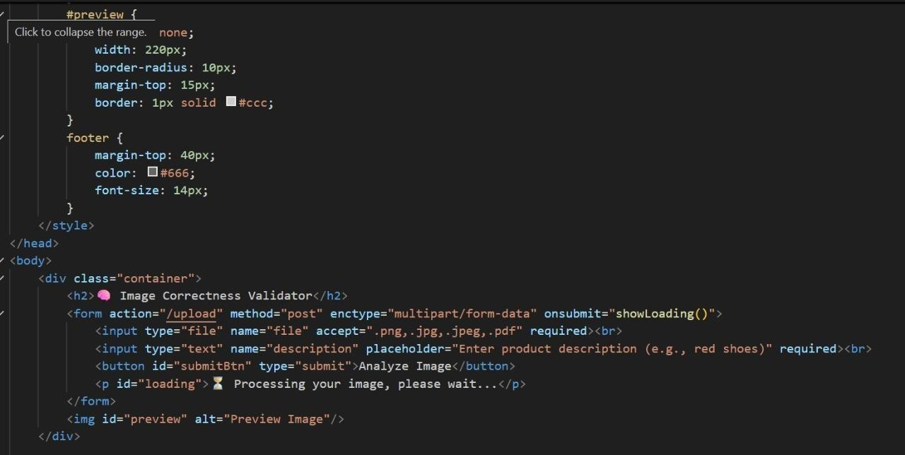
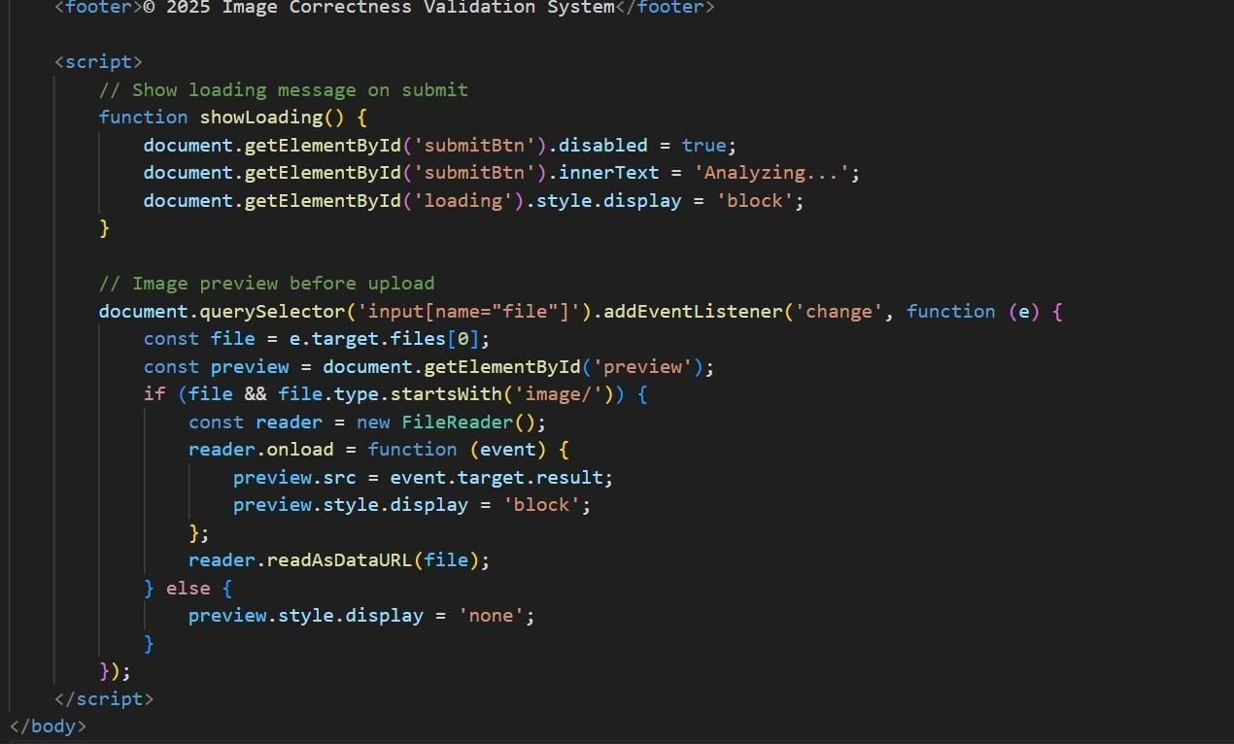
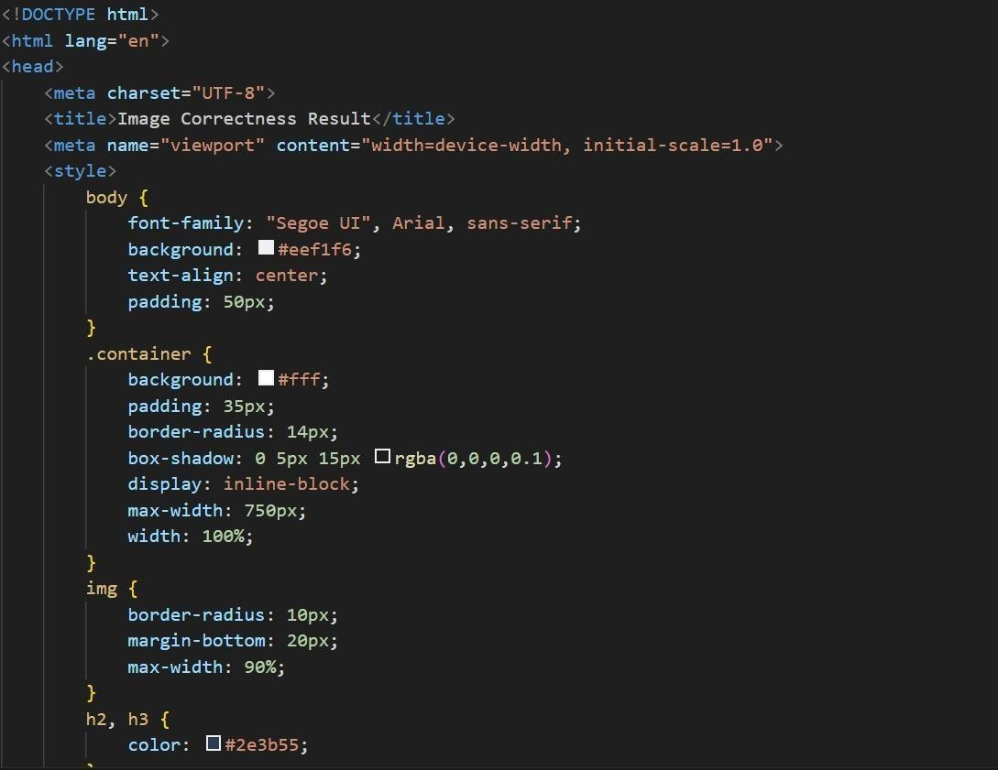
PROGRAM CODES

Slide 10
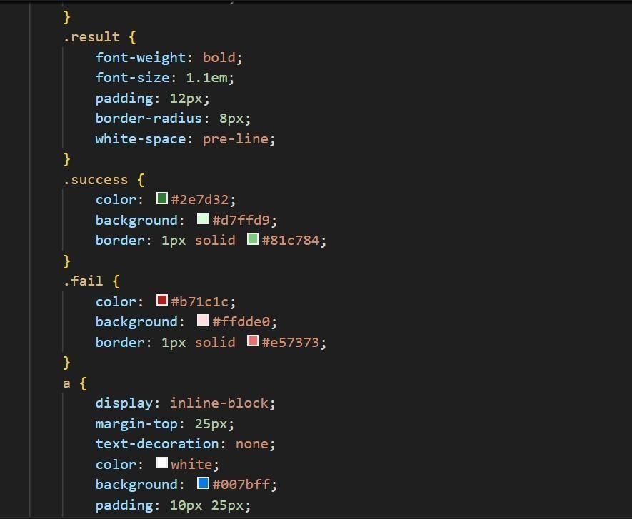
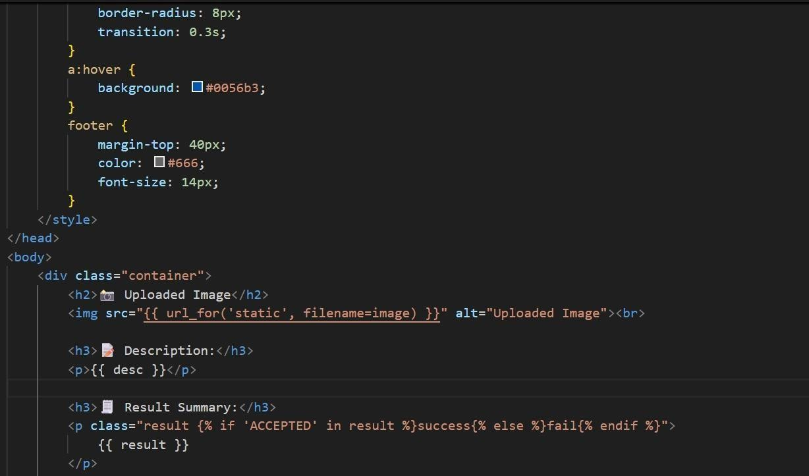
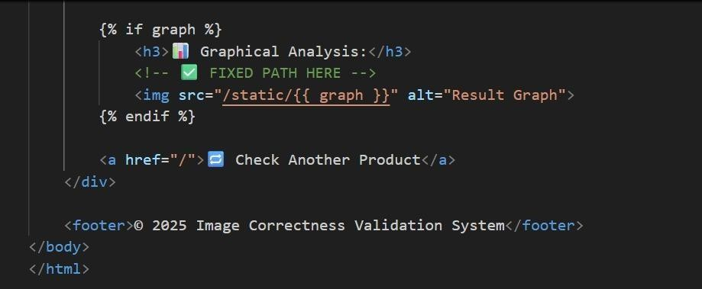
PROGRAM CODES

Slide 11

Program Code

Slide 12
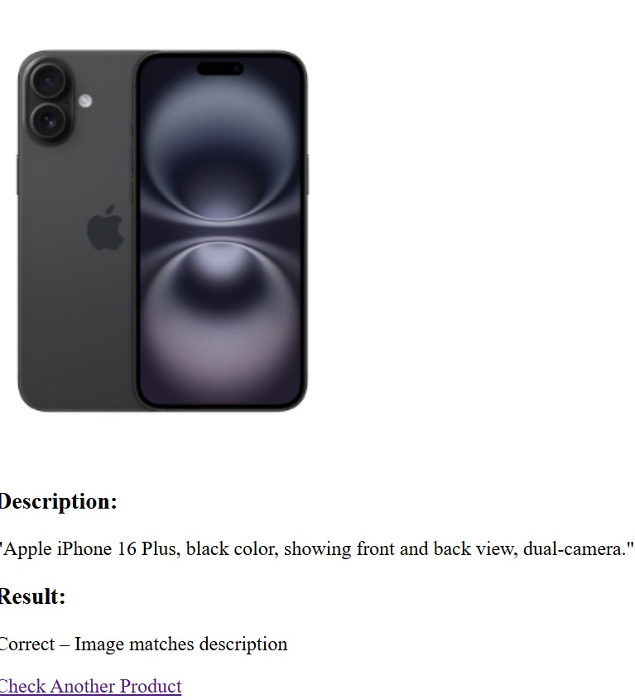
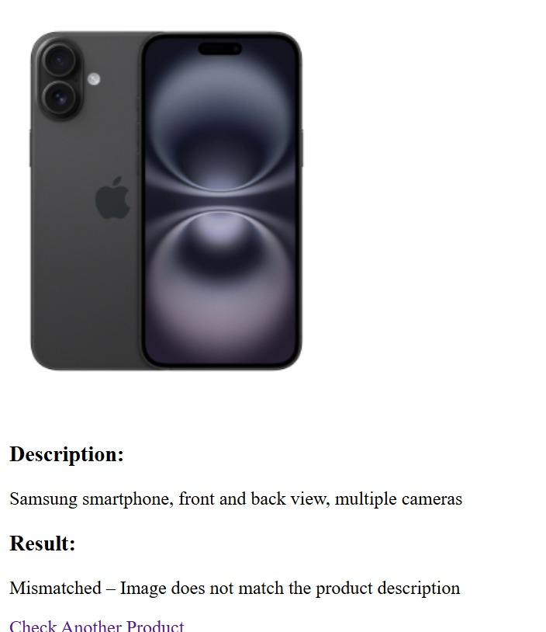

Slide 13
Hardware and Software Details
Hardware Requirements:
Processor: Intel i5/i7 or AMD equivalent
RAM: 8 GB (minimum), 16 GB (recommended)
Storage: 256 GB SSD (minimum), 512 GB+ SSD (recommended)
Graphics: Integrated GPU (basic) / Dedicated GPU (for AI/ML tasks)
Network: Stable broadband connection
Devices: Desktop/Laptop, optional mobile/tablet for testing
Software Requirements:
Operating System: Windows 10/11, Linux (Ubuntu), macOS
Backend: Node.js / Express.js, Python (if ML is involved)
Frontend: HTML, CSS, JavaScript, React.js
Database: MongoDB / Firebase
Version Control: Git & GitHub/GitLab
Tools & IDEs: VS Code, Postman, Docker (optional for deployment)
Other Utilities: APIs for image validation, cloud storage (AWS/GCP/Azure)

Slide 14
Existing Methods and Drawbacks
1. Manual Moderation
Method: Human moderators review product images uploaded by sellers and approve/reject based on marketplace guidelines.
Drawbacks:
  Time-consuming and costly.
  Not scalable for millions of listings uploaded daily.
  Subjective decisions → inconsistency in approvals.
2. Rule-Based Image Validation
Method: Platforms enforce simple rules such as minimum resolution, aspect ratio, or background color checks.
Drawbacks:
  Limited flexibility—cannot detect misleading or irrelevant product images.
  Easy for sellers to bypass rules (e.g., slightly editing images).
  Does not handle complex features like duplicate detection or text logos.

Slide 15
Existing Methods and Drawbacks
3. Traditional Computer Vision Techniques
Method: Algorithms like edge detection, histogram analysis, or template matching used for quality and relevance checks.
Drawbacks:
  Poor performance on diverse product categories (fashion, electronics, groceries).
  Sensitive to noise, lighting variations, and background clutter.
  Cannot generalize well to unseen product types.
4. Deep Learning-based Approaches (CNN, YOLO, Faster R-CNN, etc.)
Method: CNNs for classification, YOLO/Faster R-CNN for object detection, OCR for text recognition.
Drawbacks:
  High computational cost for real-time moderation.
  Require large, domain-specific training datasets.
  Individual models target specific tasks (e.g., object detection, text detection) rather than providing an end-to-end solution.

Slide 16
Proposed Method & Feasibility Study
Key Modules:
Object Detection (YOLOv5/YOLOv8): Count products, flag multiple items.
Background Validation: Plain/white vs cluttered → reject non-compliant.
Text & Watermark Detection (OCR + CNN): Block promotional text/logos/watermarks.
Image Quality Analysis: Check sharpness, brightness, resolution, cropping.
Duplicate Detection: Perceptual hashing + deep features.
Decision Engine: AI + rules → Accept/Reject with reason codes.
Feasibility:
Technical: Open-source (TensorFlow, PyTorch, OpenCV), scalable cloud deployment.
Economic: Cuts manual moderation costs, low inference cost, boosts trust.
Operational: Real-time seller feedback, seamless workflow integration.
Legal & Policy: Aligned with marketplace standards, transparent moderation.

Slide 17
Modules
Key Modules:
Image Upload Module
  Handles product image submission (formats, sizes, limits).
Image Validation Module
  Checks file type, resolution, background, watermark, and size compliance.
AI/ML Verification Module
  Detects inappropriate, duplicate, or irrelevant images.
Metadata & Tagging Module
  Associates product details, category, and brand with images.
Compliance Module
  Ensures adherence to marketplace guidelines & legal standards.
Database & Storage Module
  Stores validated images securely with version control.
Admin/Review Module
  Allows manual moderation & override when needed.

Slide 18
Github Link
The Github link provided has public access permission.
GitHub Link:
https://github.com/v-ik-s/image-correctness-capstone-project-01?tab=readme-ov-file#image-correctness-capstone-project-01

Slide 19
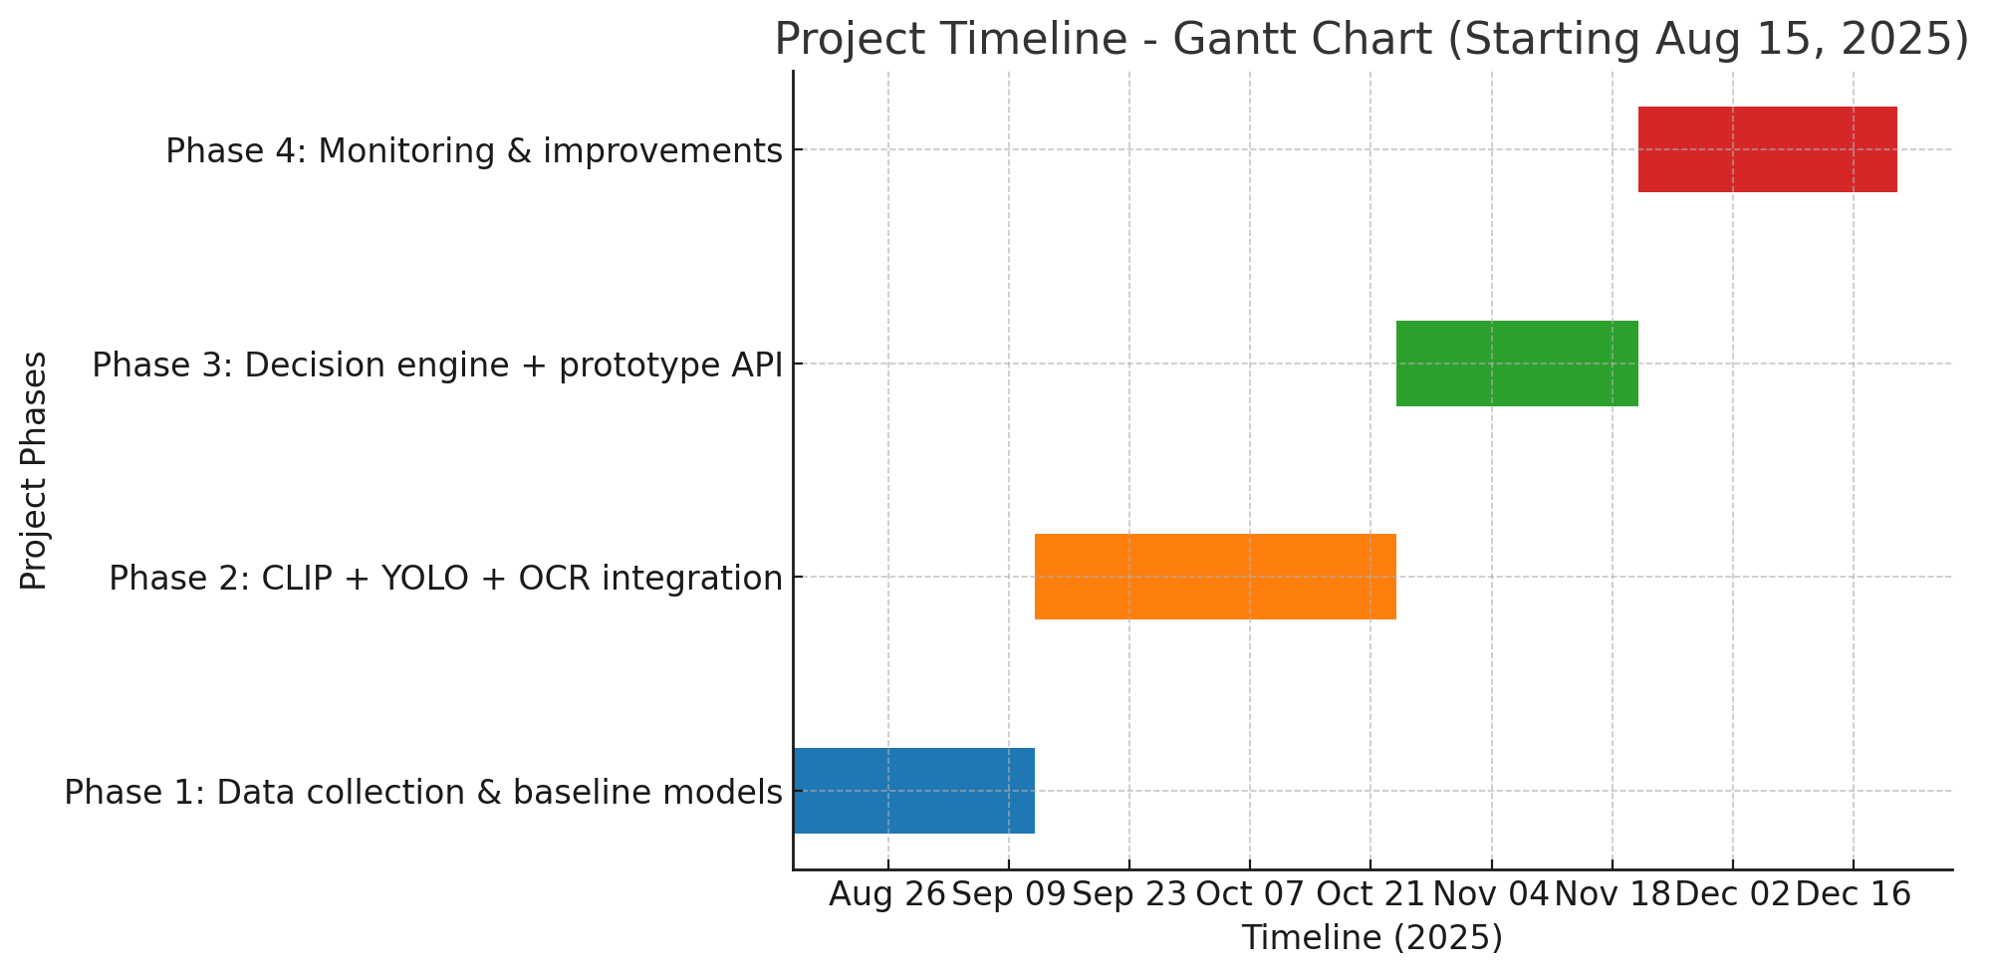
Timeline of the Project:
Phase 1 – Research & Design
Phase 2 – Implementation & Integration
Phase 3 – Testing, Evaluation & Finalization

Slide 20
References (IEEE Paper format)
A. Krizhevsky, I. Sutskever, and G. E. Hinton, “ImageNet classification with deep convolutional neural networks,” Communications of the ACM, vol. 60, no. 6, pp. 84–90, Jun. 2017.
J. Redmon and A. Farhadi, “YOLOv3: An Incremental Improvement,” arXiv preprint arXiv:1804.02767, Apr. 2018.3.
A. Dosovitskiy et al., “An Image is Worth 16x16 Words: Transformers for Image Recognition at Scale,” arXiv preprint arXiv:2010.11929, Oct. 2020.4.
A. Radford et al., “Learning transferable visual models from natural language supervision,” in Proceedings of the International Conference on Machine Learning (ICML), 2021, pp. 8748–8763.

Slide 21


